Slide 1
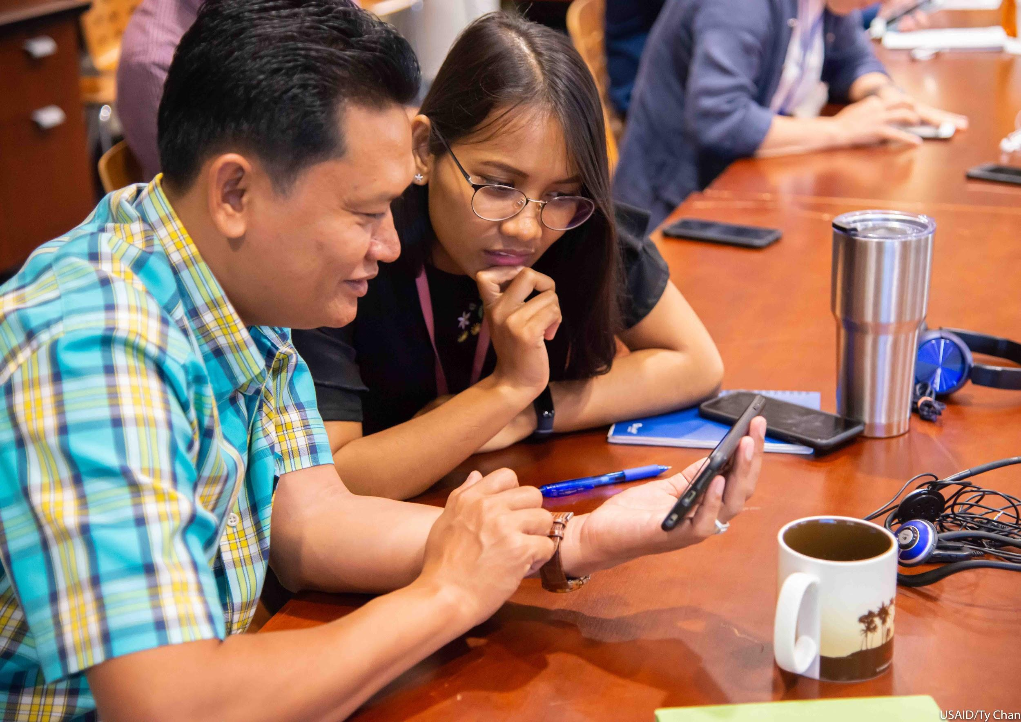
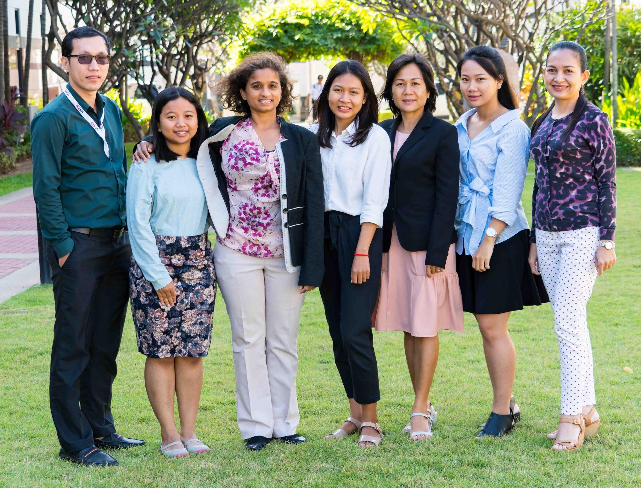
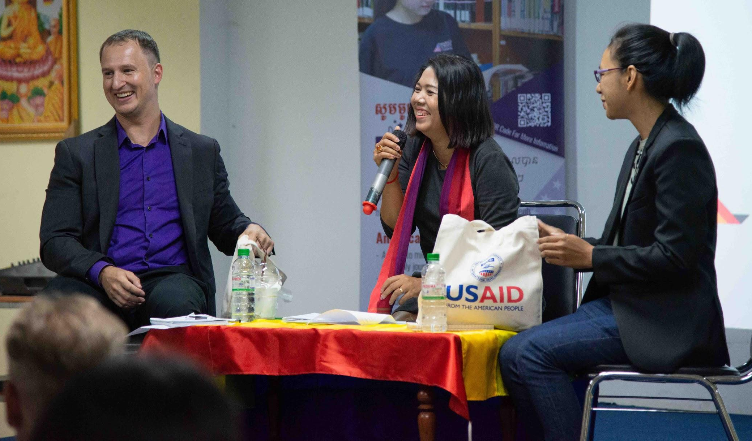
Action Alliance for Preventing Sexual Misconduct (AAPSM) Training for Implementing Partner Staff
June 26, 2019

Slide 2
វគ្គ​បណ្តុះ​បណ្តាល​​​ ស្តី​ពី​​ ចលនារួបរួមដើម្បីទប់ស្កាត់អំពើមិនគប្បីខាងផ្លូវភេទ​ ឬ​​ AAPSM​ ដល់បុគ្គលិក​អង្គការដៃគូរបស់ USAID
ខែ​មិថុនា​ 26 ឆ្នាំ 2019

Slide 3
Background​ សាវតា
March 2018: USAID Administrator Mark Green established the Action Alliance for Preventing Sexual Misconduct (AAPSM), an intra-Agency working group charged with a renewed initiative to address and prevent sexual misconduct in all its forms.
មិនា ២០១៨៖ នាយករបស់អង្គការ USAID លោក​ Mark Green បានបង្កើត​ចលនាមួយ​ឡើង​ដើម្បីទប់​ស្កាត់​អំពើ​មិន​គប្បី​ខាង​ផ្នែក​ផ្លូវ​ភេទ​​ ឬ AAPSM​ដែល​ជាក្រុមការងារអន្តរភ្នាក់ងារ​ ទទួលបន្ទុកអនុវត្ត​កិច្ចការ​ដើម្បី​ដោះ​ស្រាយ និងទប់ស្កាត់អំពើ​មិន​គប្បីខាងផ្លូវភេទ​ មិនថា​ក្នុង​ទម្រង់ណា​មួយ​ឡើយ។
April 2018: USAID/Cambodia convened a meeting with implementing partners (IPs) to discuss the issues covered under AAPSM.
មេសា ​២០១៨៖ អង្គការ USAID ប្រចាំប្រទេស​កម្ពុជា​ បានជួបប្រជុំ​ជាមួយដៃគូ​អនុវត្ត (IP)​ ដើម្បី​ពិភាក្សាជុំវិញបញ្ហានានាទាក់ទងនឹង AAPSM។
Notes:
Action Alliance for Preventing Sexual Misconduct (AAPSM):
In March 2018, Administrator Green launched the Action Alliance for Preventing Sexual Misconduct, or “AAPSM.”
The Action Alliance is an intra-agency working group charged with leading USAID’s efforts to improve prevention and response to sexual misconduct—both in Washington and here in our Mission.
USAID, through the AAPSM, is taking steps to ensure that allegations of sexual harassment, exploitation, and abuse within USAID’s workplace and programs are reported immediately and addressed appropriately.
I convened a similar meeting last year, shortly after the AAPSM’s launch, to discuss these issues with you, our key partners.
Core Message:
This means that USAID strictly prohibits sexual misconduct, including harassment, exploitation, or abuse of any kind among USAID staff or implementing partners. USAID affirms that sexual misconduct is counter to our Agency’s core values, and the Agency will take necessary steps to prevent and address sexual misconduct within its workforce and programs, while also accounting for the needs of survivors.

Slide 4
Background​ សាវតា
October 2018: Mission Directors and other senior managers were tasked with promoting a culture change around sexual misconduct within their teams by modeling respect, inclusion, and accountability.
តុលា ២០១៨៖ នាយក-នាយិកាបេសកកម្មនានា រួមជាមួយថ្នាក់ដឹកនាំជាន់ខ្ពស់ដទៃទៀត ត្រូវបានចាត់តាំងឲ្យសម្រេចកិច្ចការទាក់ទងនឹងការលើកកំពស់ការផ្លាស់ប្តូរវប្បធម៌​អំពី អំពើមិនគប្បីខាងផ្នែកផ្លូវភេទ​ ជាមួួយ​​នឹង​ក្រុម​ការងារ​របស់​ខ្លួន​ ដោយយក​ជាធំនូវ​ ការគោរព បរិយាប័ន្ន​ និងការទទួល​ខុស​ត្រូវ។
Core Message: USAID has zero tolerance for sexual misconduct.
សារសំខាន់៖ USAID​ មិនអត់អោនជាដាច់ខាតចំពោះអំពើមិនគប្បីខាងផ្នែក​ផ្លូវភេទ។
Notes:
Action Alliance for Preventing Sexual Misconduct (AAPSM):
In March 2018, Administrator Green launched the Action Alliance for Preventing Sexual Misconduct, or “AAPSM.”
The Action Alliance is an intra-agency working group charged with leading USAID’s efforts to improve prevention and response to sexual misconduct—both in Washington and here in our Mission.
USAID, through the AAPSM, is taking steps to ensure that allegations of sexual harassment, exploitation, and abuse within USAID’s workplace and programs are reported immediately and addressed appropriately.
I convened a similar meeting last year, shortly after the AAPSM’s launch, to discuss these issues with you, our key partners.
Core Message:
This means that USAID strictly prohibits sexual misconduct, including harassment, exploitation, or abuse of any kind among USAID staff or implementing partners. USAID affirms that sexual misconduct is counter to our Agency’s core values, and the Agency will take necessary steps to prevent and address sexual misconduct within its workforce and programs, while also accounting for the needs of survivors.

Slide 5
Zero Tolerance មិនមានការអត់អោនជាដាច់ខាត
USAID prohibits sexual misconduct of any kind, including harassment, exploitation, or abuse, among USAID staff or our implementing partners.
USAID ហាមអំពើមិនគប្បី​ខាងផ្លូវភេទ​ ក្នុងគ្រប់រូបភាពទាំងអស់​ រួមមាន ការបៀតបៀន ការកេងប្រវ័ញ្ច ឬរំលោភបំពាន មិនថាប្រព្រឹត្តិដោយបុគ្គលិក USAID ផ្ទាល់ ឬបុគ្គលិកដៃគូអនុវត្តគម្រោងឡើយ។
Sexual misconduct is counter to our Agency’s core values.
អំពើមិនគប្បីខាងផ្លូវភេទ គឺផ្ទុយស្រឡះពីគុណតម្លៃដ៏សំខាន់របស់ភ្នាក់ងារ។

Slide 6
Zero Tolerance មិនមានការអត់អោនជាដាច់ខាត
Sexual misconduct fundamentally strikes at the very foundation of international development by causing intolerable harm to its victims, threatening our mission, and undermining the credibility of the entire aid sector.
អំពើមិនគប្បីខាងផ្លូវភេទ​ បង្កឲ្យមានផលប៉ះពាល់យ៉ាងខ្លាំងទៅលើមូលដ្ឋាននៃការអភិវឌ្ឍន៍អន្តរជាតិ​ ដោយសារ​ការណ៍នេះនឹង​បង្ក​ឲ្យ​មាន​ភាពអត់អោន​ទៅលើ​ការបំពារបំពាន​ដែលកើតឡើងចំពោះជនរងគ្រោះ​ គំរាមកំហែងដល់បេសកកម្មរបស់យើង​ ហើយថែមទាំងធ្វើឲ្យ​អាប់អោនដល់​កិត្តិនាមនវិស័យ​ផ្តល់​ហិរញ្ញប្បទាន​ទាំង​មូល​ទៀត​ផង។
USAID will take necessary and appropriate steps to prevent and address sexual misconduct within our workforce and programs, while also accounting for survivor needs.
USAID​ នឹង​ចាត់វិធានការចាំបាច់​ និងសាកសម​ដើម្បី​ទប់ស្កាត់​ និងដោះស្រាយ​អំពើមិនគប្បីខាងផ្លូវភេទដែលកើត​មាន​នៅ​ក្នុង​កន្លែង​ធ្វើ​ការ​ និង​គម្រោង​របស់ យើង​ ខណ:ពេលដែលទទួលខុសត្រូវលើតម្រូវការនានារបស់ជនរងគ្រោះ។

Slide 7
Exercise: Terminology លំហាត់៖​ វាក្យស័ព្ទ

Slide 8
Term​ ពាក្យ | Definition និយមន័យ
Sexual Misconduct អំពើមិនគប្បី​ខាង​ផ្លូវភេទ
Umbrella term that encompasses any inappropriate behavior of a sexual nature or that is sex-based, including sexual abuse, sexual assault, sexual exploitation, sexual harassment, intimate partner violence, stalking, voyeurism, and any other such conduct that is non-consensual or has the purpose or effect of threatening, intimidating, denigrating, or coercing a person.
ជា​ពាក្យ​ដែលក្តោបទៅលើរាល់ឥរិយាបថទាំងឡាយណាដែលមិន​គួរសម​ ហើយ​ទាក់​ទង​នឹង​ផ្លូវ​ភេទ​ ឬដោយសារតែរឿងភេទ រួមមាន​ការរំលោភ​បំពាន​ផ្លូវភេទ ការបំពារបំពានផ្លូវភេទ​ ការកេងប្រវ័ញ្ច​ផ្លូវភេទ ការ​បៀត​បៀន​ផ្លូវភេទ​ អំពើហិង្សាលើដៃគូរួមស្នេហា​ ការ​លួចលបមើល​ ការលួចមើលគេរួមភេទ និងអំពើមិនគប្បីនានាទៀតដែលមិនមានការ​យល់​ព្រម​ ឬក្នុងគោលបំណង​ ឬចង់បង្កឲ្យមានការ​គំរាម​កំហែង បំភ័យ បន្ទាបបន្ថោក ឬចេតនាលួងលោមនរណាម្នាក់។

Slide 9
Term​ ពាក្យ | Definition និយមន័យ
Sexual Harassment ការ​បៀត​បៀន​ផ្លូវភេទ
Misconduct of a sexual nature or about a person’s sex that is so frequent or severe as to create a hostile or offensive work environment or that results in an adverse employment decision, such as the victim being fired or demoted. It can include verbal or physical harassment of a sexual nature, as well as offensive remarks related to a person’s sex.
ជាអំពើមិនគប្បីទាក់ទងនឹងផ្លូវភេទ​ ឬអំពីភេទរបស់ជនណាមួយដែលកើតឡើងជាញឹក​ញាប់​ ឬក្នុងកម្រិតធ្ងន់ធ្ងរ ដែលនេះអាច​បង្កឲ្យមាន​​បរិយាកាស​មិនល្អនៅក្នុងការិយាល័យ ឬធ្វើឲ្យ​ប៉ះពាល់ផ្លូវចិត្ត​បុគ្គលិក ឬ​ដែល​បណ្តាល​ឲ្យ​ប៉ះពាល់ដល់លទ្ធផលការ​ងារ​របស់គេ​​ ដូចជា​ ជនរងគ្រោះត្រូៈ​បញ្ឈប់​ពីការងារ ឬត្រូវបានទម្លាក់ពីតំណែង។ អំពើ​បៀត​បៀនទាំងអស់អាច​កើត​មានតាមរយ: ពាក្យសម្តី ឬកាយវិការ ដែលទាក់ទងនឹងផ្លូវភេទ ឬ​ពាក្យ​ពេចន៍​មិនគប្បីអំពីភេទរបស់នរណាម្នាក់។

Slide 10
Term​ ពាក្យ | Definition និយមន័យ
Sexual Exploitation ការ​កេង​ប្រវ័ញ្ច​ផ្លូវ​ភេទ
Sexual Abuse ការ រំលោភ​បំពានផ្លូវ​ភេទ
Any actual or attempted abuse by aid workers of a position of vulnerability, differential power, or trust, for sexual purposes, including profiting monetarily, socially, or politically from the sexual exploitation of another.
ការរំលោភបំពានទាំងឡាយណា​ មិនថាកើតឡើងជាក់ស្តែង ឬគ្រាន់​តែ​ប៉ុន​ប៉ង ដែលបង្កដោយបុគ្គលិកជំនួយនៃលក្ខខណ្ឌ ងាយរង​គ្រោះ​ មានអំណាចខុសគ្នា​ ឬដោយសារ​មាន​ទំនុក​ចិត្ត​ ក្នុងគោល​បំណង​ផ្លូវ​ភេទ ដោយទទួល​ផលចំណេញផ្នែក​ហិរញ្ញវត្ថុ ផ្នែកសង្គម ឬផ្នែក​នយោបាយ ពីការ​កេងប្រវ័ញ្ច​ផ្លូវភេទ​ពីជនណាម្នាក់។
Any actual or threatened physical intrusion of a sexual nature, whether by force or under unequal or coercive conditions.
រាល់ការបំពារបំពានរាងកាយទាំងឡាយណា មិនថាកើតឡើងជាក់ស្តែង ឬតាមរយ:​ការ​គំរាម​កំហែង​ដែលពាក់ព័ន្ធនឹងផ្លូវ​ភេទ​ មិនថាដោយការបង្ខំ ឬក្រោមលក្ខខណ្ឌដែល​គ្មាន​ភាពស្មើ​គ្នា​ ឬដោយការលួងលោម។

Slide 11
The misconduct does not need to rise to the level of civil or criminal illegality to warrant corrective or disciplinary action.
រាល់​អំពើមិនគប្បី មិនចាំបាច់ ទាល់តែធំ​ដល់កម្រិតខុសច្បាប់ខាងរដ្ឋប្បវេណី ឬឧក្រិដ្ឋនោះទេ​ សុទ្ធតែតម្រូវឲ្យមានវិធានការកែតម្រូវ ឬពិន័យ។

Slide 12
Preventing Sexual Exploitation and Abuse (1) ទប់ស្កាត់ការកេងប្រវ័ញ្ច និងការរំលោភបំពានផ្លូវភេទ (1)
USAID prohibits all of our contractors, sub-contractors, grantees, and sub-grantees (including their employees), during the period of performance of their contracts or awards, and regardless of award amount, from engaging in trafficking in persons, procuring commercial sex acts, and using forced labor.
USAID ហាមរាល់ស្ថាប័នជាប់កិច្ចសន្យា​ អនុ​កិច្ចសន្យា ដៃគូអនុវត្តគម្រោង​ និងអនុដៃគូអនុវត្តគម្រោង (រួមទាំងបុគ្គលិក)​ ក្នុងអំឡុងពេលបំពេញការងារទៅតាមកិច្ចសន្យា ឬគម្រោង​របស់​ពួក​គេ​ មិនថា​ទឹកប្រាក់ចំនួនប៉ុន្មាន មិន​ឲ្យ​ជាប់ពាក់ព័ន្ធ​នឹងការជួញដូរមនុស្ស​ ទិញសេវាផ្លូវភេទ និងការបង្ខំកម្លាំងពលកម្ម។
Notes:
I would like to use this opportunity to remind all of you about your responsibilities to prevent sexual exploitation and abuse in USAID-funded programming.

Slide 13
Preventing Sexual Exploitation and Abuse (2) ទប់ស្កាត់ការកេងប្រវ័ញ្ច និងការរំលោភបំពានផ្លូវភេទ (2)
For awards with services performed overseas greater than $500,000, the prime partner must annually certify to its USAID Contracting or Agreement Officer that it has a compliance plan in place to prevent prohibited trafficking-related activities, including procuring commercial sex.
ចំពោះគម្រោងដែលត្រូវបំពេញការងារនៅ​ក្រៅប្រទេស​ ហើយមានតម្លៃ​លើស​ពី 500,000 (៥សែន)​ ដុល្លារអាមេរិក ដៃគូជាប់កុងត្រា​​ ត្រូវ​​បញ្ជាក់ជារៀងរាល់​ឆ្នាំ​មក​កាន់​មន្ត្រី USAID ទទួលបន្ទុកខាង​កិច្ចសន្យា​ ឬ​​កិច្ច​ព្រមព្រៀង​ ថាស្ថាប័នរបស់ពួកគេមាន​គម្រោង​ក្នុងការទប់ស្កាត់សកម្ម​ភាព​ទាំងឡាយណាទាក់ទងនឹងការជួញដូរមនុស្ស បូករួមទាំងការទិញ​សេវា​ផ្លូវភេទផងដែរ។

Slide 14
Preventing Sexual Exploitation and Abuse (3) ទប់ស្កាត់ការកេងប្រវ័ញ្ច និងការរំលោភបំពានផ្លូវភេទ (3)
USAID also includes additional protections in grants and contracts to promote the safeguarding of children and youth under the age of 18, and to protect them against abuse, exploitation, and neglect in the implementation of USAID-funded programs.
USAID​ ក៏បញ្ចូលបន្ថែមផងដែរ​នូវបញ្ញត្តិការពារទាំងក្នុងកិច្ចព្រមព្រៀង​ជំនួយ​ និង​កិច្ច​សន្យា​ ដើម្បី​លើកកម្ពស់​ការគាំពារកុមារ និងយុវជន​ដែលមានវ័យក្រោម១៨ឆ្នាំ ហើយ​ដើម្បី​ការពារ​ពួកគេ​ពីការរំលោភ​បំពាន​ ការកេងប្រវ័ញ្ច និងការមិនយកចិត្តទុកដាក់ នៅពេលអនុវត្តកម្មវិធីដែលទទួលជំនួយ​ពី USAID។

Slide 15
Partner Codes of Conduct ច្បាប់អនុវត្តសម្រាប់ដៃគូ
Codes of conduct for all implementing partner employees must meet internationally recognized standards outlined by the Inter-Agency Standing Committee (IASC) Protection from Sexual Exploitation and Abuse Task Force.
ច្បាប់អនុវត្តសម្រាប់បុគ្គលិកដៃគូអនុវត្តកម្មវិធីទាំងអស់ ត្រូវសមស្របទៅនឹងបទដ្ឋានដែលទទួលស្គាល់ជាលក្ខណ:អន្តរជាតិ ដូចដែលមានចែងដោយក្រុមការងារនៃ​គណ:​កម្មាធិការអចិន្ត្រៃយ៍អន្តរភ្នាក់ងារ (IASC) ស្តីពីការការពារពី​ការកេងប្រវ័ញ្ច​ផ្លូវភេទ
Implementing partners are required to consult with the Agreement Officer, or Contracting Officer, and the Mission Director when an employee’s conduct violates IASC standards.
ដៃគូអនុវត្តកម្មវិធីទាំងអស់​ត្រូវ​ពិភាក្សាជាមួយ​មន្ត្រី​កិច្ចព្រមព្រៀង​ ឬមន្ត្រីកិច្ចសន្យា​ និងនាយក-នាយិកាបេសកកម្មនៅពេល​ដែល​បុគ្គលិកណាម្នាក់​បំពាន​ច្បាប់អនុវត្ត​ដែល​មាន លក្ខណ:បទដ្ឋាន IASC​ នេះ។
Notes:
Codes of conduct for all USAID implementing partner employees must meet internationally recognized standards on preventing sexual exploitation and abuse, namely the six core principles of the Inter-Agency Standing Committee (IASC) Protection from Sexual Exploitation and Abuse Task Force.
Sexual exploitation and abuse by humanitarian workers constitute acts of gross misconduct and are therefore grounds for termination of employment.
Sexual activity with children (persons under the age of 18) is prohibited regardless of the age of majority or age of consent locally. Mistaken belief regarding the age of a child is not a defence.
Exchange of money, employment, goods, or services for sex, including sexual favours or other forms of humiliating, degrading or exploitative behaviour is prohibited. This includes exchange of assistance that is due to beneficiaries.
Sexual relationships between humanitarian workers and beneficiaries are strongly discouraged since they are based on inherently unequal power dynamics. Such relationships undermine the credibility and integrity of humanitarian aid work.
Where a humanitarian worker develops concerns or suspicions regarding sexual abuse or exploitation by a fellow worker, whether in the same agency or not, he or she must report such concerns via established agency reporting mechanisms.
Humanitarian workers are obliged to create and maintain an environment which prevents sexual exploitation and abuse and promotes the implementation of their code of conduct. Managers at all levels have particular responsibilities to support and develop systems which maintain this environment.
Last year, we updated our grant standard provisions and contract clauses to clarify that codes of conduct for all USAID implementing partner employees must meet internationally-recognized standards on preventing sexual exploitation and abuse
This update was consistent with existing requirements for any organization that receives International Disaster Assistance, Transition Initiative, or Title II Food for Peace funding from USAID, which mandate a written code of conduct consistent with the IASC principles.

Slide 16
Partner Codes of Conduct ច្បាប់អនុវត្តសម្រាប់ដៃគូ
Implementing partners are required to propose an appropriate course of action for that employee.
ដៃគូអនុវត្តកម្មវិធី​ ត្រូវស្នើរវិធានការដែលសាកសម​សម្រាប់​ដោះ​ស្រាយ​ជាមួយ​បុគ្គលិក​រូប​នោះ។
U.S. Ambassador is empowered to require an IP to remove problem employees from USAID-funded awards, and if the employee is a U.S. citizen, to direct the removal of that individual from the country.
អគ្គរដ្ឋទូតអាមេរិក មានអំណាចក្នុងការតម្រូវ​ឲ្យ​ដៃគូអនុវត្ត​កម្មវិធី​បញ្ឈប់បុគ្គលិកពីកម្មវិធី​ដែលទទួលជំនួយ​ពី USAID ហើយ​បើ​បុគ្គលិក​នោះ​ជា​ជន​ជាតិ​អាមេរិក ត្រូវបញ្ជារ​ឲ្យបញ្ជូន​ជននោះ​ចេញពីប្រទេសកម្ពុជា។
Notes:
Codes of conduct for all USAID implementing partner employees must meet internationally recognized standards on preventing sexual exploitation and abuse, namely the six core principles of the Inter-Agency Standing Committee (IASC) Protection from Sexual Exploitation and Abuse Task Force.
Sexual exploitation and abuse by humanitarian workers constitute acts of gross misconduct and are therefore grounds for termination of employment.
Sexual activity with children (persons under the age of 18) is prohibited regardless of the age of majority or age of consent locally. Mistaken belief regarding the age of a child is not a defence.
Exchange of money, employment, goods, or services for sex, including sexual favours or other forms of humiliating, degrading or exploitative behaviour is prohibited. This includes exchange of assistance that is due to beneficiaries.
Sexual relationships between humanitarian workers and beneficiaries are strongly discouraged since they are based on inherently unequal power dynamics. Such relationships undermine the credibility and integrity of humanitarian aid work.
Where a humanitarian worker develops concerns or suspicions regarding sexual abuse or exploitation by a fellow worker, whether in the same agency or not, he or she must report such concerns via established agency reporting mechanisms.
Humanitarian workers are obliged to create and maintain an environment which prevents sexual exploitation and abuse and promotes the implementation of their code of conduct. Managers at all levels have particular responsibilities to support and develop systems which maintain this environment.
Last year, we updated our grant standard provisions and contract clauses to clarify that codes of conduct for all USAID implementing partner employees must meet internationally-recognized standards on preventing sexual exploitation and abuse
This update was consistent with existing requirements for any organization that receives International Disaster Assistance, Transition Initiative, or Title II Food for Peace funding from USAID, which mandate a written code of conduct consistent with the IASC principles.

Slide 17
Reporting Requirements តម្រូវការក្នុងការរាយការណ៍
USAID strongly encourages contractors and grantees to notify the Office of USAID’s Inspector General (OIG) immediately of suspected allegations of sexual exploitation and abuse, and to cooperate in any audits, investigations, or corrective actions.
USAID លើកទឹកចិត្តខ្ពស់ឲ្យដៃគូអនុវត្តកម្មវិធី និងកិច្ចសន្យា ផ្តល់ដំណឹង​ដល់អគ្គនាយកដ្ឋាន​ត្រួតពិនិត្យរបស់ USAID​ (OIG) ភ្លាមៗក្រោយ​មាន​ការសង្ស័យ​ទៅ​លើការចោទប្រកាន់ថាមានករណីកេងប្រវ័ញ្ច​ ឬការរំលោភបំពានផ្លូវភេទ ហើយសហការក្នុងករណីមានការធ្វើសវនកម្ម ការស៊ើបអង្កេត ឬសកម្មភាពកែតម្រូវណាមួយ។
To contact the OIG, please visit https://oig.usaid.gov , or call 1-800-230-6539.
ដើម្បីទាក់ទង OIG សូមចូលទៅកាន់ https://oig.usaid.gov ឬទូរស័ព្ទទៅលេខ 1-800-230-6539

Slide 18
Resources ឯកសារពាក់ព័ន្ធនានា
The AAPSM Website: www.usaid.gov/PreventingSexualMisconduct
Features fact sheets, flowcharts, and information on USAID’s policies and processes, which are equally helpful to USAID’s staff and implementing partners.
វិបសាយ AAPSM៖ www.usaid.gov/PreventingSexualMisconduct
មានព័ត៌មានសង្ខេបៗ​ រូបភាព និងព័ត៌មានដទៃទៀតដែលទាក់ទងនឹង​គោលនយោបាយ​ និងដំណើរការរបស់ USAID ដែលអាចផ្តល់ជាជំនួយដល់បុគ្គលិក USAID​​ និងដៃគូអនុវត្តគម្រោង។
IASC Six Core Principles Relating to Sexual Exploitation and Abuse (link)
គោលការណ៍ចំបងទាំង៦​ របស់ IASC ទាក់ទងនឹងការកេងប្រវ័ញ្ច និងការរំលោភ​បំពាន​ផ្លូវភេទ (តំណភ្ជាប់)
Notes:
Policies
Additional tools and guides will accompany both policies to help translate them into direct action.
USAID will also consult closely and meaningfully with a wide range of stakeholders, including implementing partners, to make sure these policies are rigorous and responsive to evolving needs on the ground.

Slide 19
Resources ឯកសារពាក់ព័ន្ធនានា
USAID is developing two, new comprehensive policies targeted for release in the coming weeks.
USAID កំពុងបង្កើតគោលនយោបាយថ្មីចំនួន២​ ដែលគ្រោងនឹង​ដាក់​ឲ្យ​អនុវត្ត​ក្នុងពេលឆាប់ៗនេះ។
New Chapter in the Agency’s operational policy, the Automated Directives System (ADS), related to internal sexual misconduct and harassment. This policy will lay out expectations for USAID staff, and guide the Agency’s response in cases of internal sexual misconduct.
ជំពូកថ្មីនៃគោលនយោបាយអនុវត្តរបស់ភ្នាក់ងារ​ ដែលមានឈ្មោះថា ADS ទាក់ទងនឹងអំពើមិនគប្បី​ និង​ការបៀតបៀន​ខាងផ្លូវភេទ​ សម្រាប់ប្រើប្រាស់​​ក្នុងភ្នាក់ងារផ្ទាល់។​ គោលការណ៍នេះនឹង​រៀបរាប់អំពីការរំពឹងទុក​ដែលតម្រូវឲ្យបុគ្គលិក USAID​ ត្រូវគោរពតាម និងជួយ​តម្រង់​ទិស​ការឆ្លើយតបរបស់ភ្នាក់ងារ​ ក្នុងករណីដែលមានអំពើមិនគប្បីខាងផ្លូវភេទកើត​ឡើង។
Notes:
Policies
Additional tools and guides will accompany both policies to help translate them into direct action.
USAID will also consult closely and meaningfully with a wide range of stakeholders, including implementing partners, to make sure these policies are rigorous and responsive to evolving needs on the ground.

Slide 20
Resources ឯកសារពាក់ព័ន្ធនានា
Policy on Protection from Preventing Sexual Exploitation and Abuse (PSEA) that will clarify roles, responsibilities, and processes for protecting USAID’s beneficiaries.
គោលនយោបាយស្តីពីការការពារ ការទប់ស្កាត់​ការកេងប្រវ័ញ្ច និងការរំលោភ​បំពាន​ផ្លូវភេទ (PSEA)​ ដែលនឹងរៀបរាប់អំពីតួនាទី ការ​ទទួល​ខុស​ត្រូវ និង​ដំណើរ​ការ​ដើម្បី​ការពារ​អ្នកទទួលផល​របស់​ USAID។
Notes:
Policies
Additional tools and guides will accompany both policies to help translate them into direct action.
USAID will also consult closely and meaningfully with a wide range of stakeholders, including implementing partners, to make sure these policies are rigorous and responsive to evolving needs on the ground.

Slide 21
Questions & Discussion សំណួរ​ និងការពិភាក្សា
Notes:
As the frontline implementers of USAID programming, all of you—and your sub-contractors and sub-grantees—have a solemn responsibility to protect our beneficiaries.
I would like to use the remainder of our time today to open the floor up to thoughts and feedback, particularly around how we can work together to build capacity and strengthen protections around preventing sexual exploitation and abuse.
Please share what your organizations are doing in this space. What is working? Where are areas for improvement? How can we at USAID better tailor our approach to on-the-ground needs?
We will capture your feedback and incorporate it into USAID’s ongoing efforts.
Thank you for your time and help.

